Slide 1
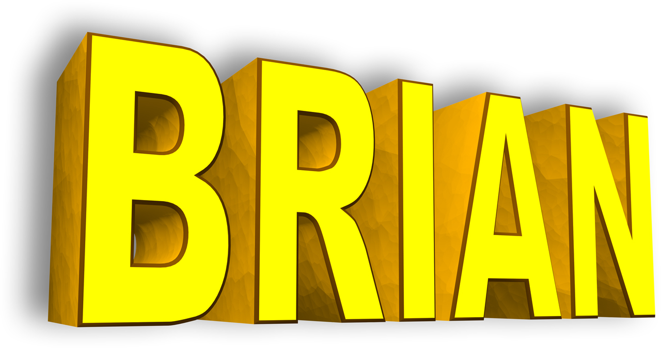
http://www.briansimulator.org
Romain Brette
Institut de la Vision, Paris
romain.brette@inserm.fr
Neural simulation in the post-connectionist era
Main developers of : Dan Goodman & Marcel Stimberg
Notes:
* Brian is a simulator for spiking neural networks in Python
1

Slide 2
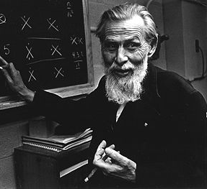
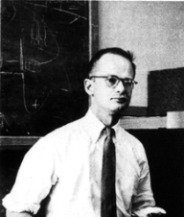
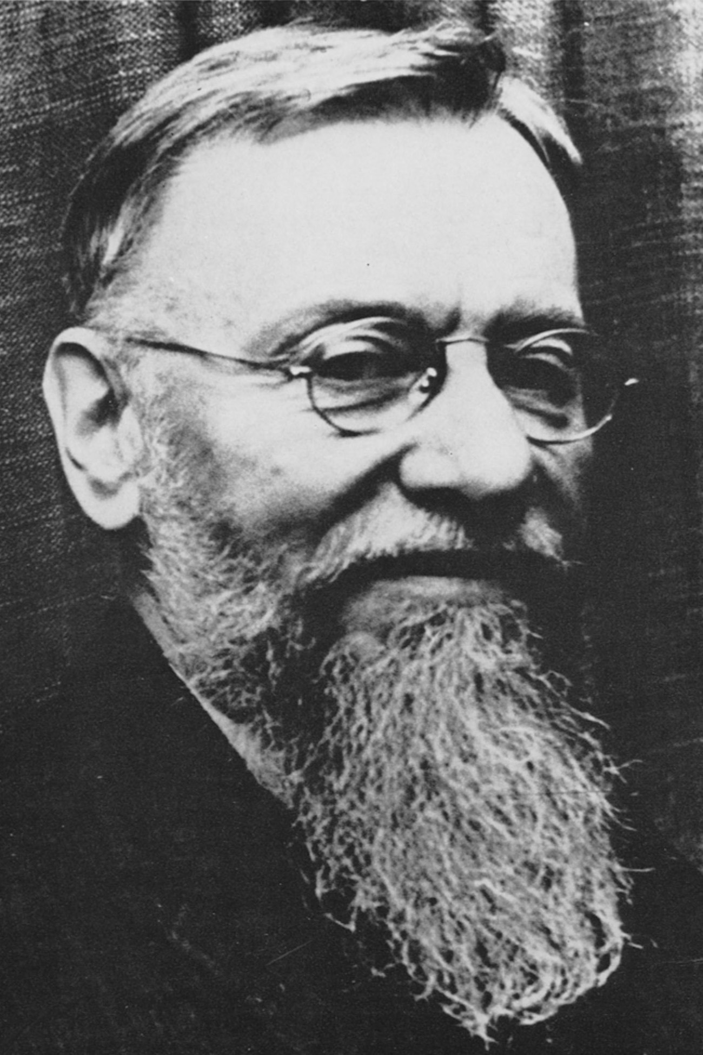
The old neural models
0
1
0
1
binary units (active/inactive)
discrete time
1
McCulloch & Pitts
« A logical calculus of the ideas immanent in nervous activity » (1943)
Why getting rid of time?
Earlier models: continuous time
Nicolas Rashevsky
Outline of a physico-mathematical theory of excitation and inhibition (1933)
Motivation = isomorphism with calculus of logical propositions
t -> t+1 = inference
Notes:
In connectionnism
Here « time » has little to do with physical time.

Slide 3
The old neural models
0
1
0
1
1
McCulloch & Pitts
« A logical calculus of the ideas immanent in nervous activity » (1943)
No time
=> structural parameters = connection weights and activation threshold
=> connectionism
Learning = modifying weights
Notes:
Connectionnism has influenced the way we think about the brain and also experiments (measuring synaptic plasticity).
Hebbian plasticity, etc

Slide 4
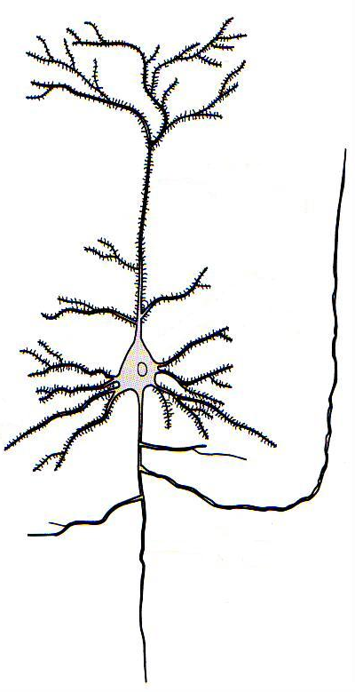
Spiking neuron models
Output =
1 spike train
Input =
N spike trains
A neuron model is defined by:
what happens when a spike is received
the condition for spiking
what happens when a spike is produced
what happens between spikes
discrete events
continuous dynamics
Notes:
Neuromorphic systems implement spiking neuron models

Slide 5
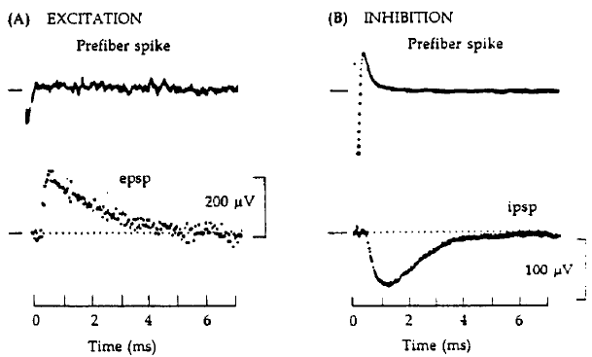
Spiking neuron models
Time is back!
Output =
1 spike train
Input =
N spike trains
=> Many more structural parameters!
« weight »
duration
+ conduction delay
etc
X
connectionism
Notes:
Unappreciated consequence: now connection = function of time, not value.
This basically kills standard connectionism.

Slide 6
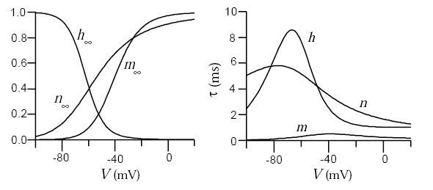
What do we know about learning for other parameters?
also: plasticity is plastic
(meta-plasticity)
Next to nothing!
But: about every element of structure is plastic
position of synapses
position of initiation site
conduction delay
neurotransmitter
release
expression of ionic channels
properties of ionic channels
Notes:
Because of the connectionism lens, we have focused on changes in synaptic strength and just did not look at the rest.
(conceptually, next to nothing)
Rather: we know that they change

Slide 7
The future of neural models
(time)
Current models:
(no time)
synaptic weights
Hebbian learning
connectionism
post-connectionism
Future models:
everything else
plasticity rules for everything else
Notes:
Connectionism follows from the dismissal of time

Slide 8
How to simulate post-connectionist models?
PROBLEM #1: Flexibility
=> standardization is a bad idea!
1
PROBLEM #2: Speed and hardware implementation
2
Notes:
Models are not established yet!
#2 and #1 seem contradictory

Slide 9
Problem #1: Flexibility

Slide 10
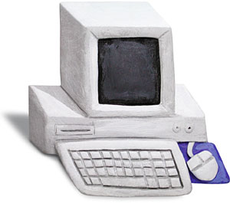
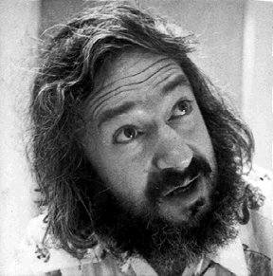
The spirit of
“A simulator should not only save the time of processors, but also the time of scientists”
scientist
computer
Writing code often takes more time than running it
Goals:
Quick model coding
Flexible
models are defined by equations (rather than pre-defined)
Goodman, D. and R. Brette (2009). The Brian simulator. Front Neurosci doi:10.3389/neuro.01.026.2009.
Notes:
Motto of Brian: Brian is optimized for productivity
For those cases: simplifies model coding but flexible
Our approach: define models with equations
Examples

Slide 11
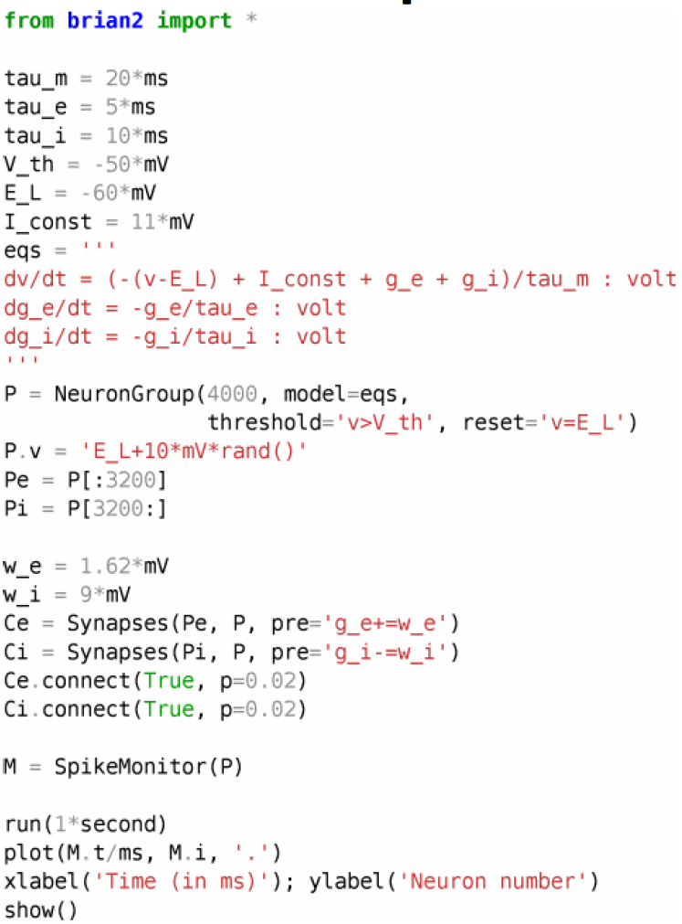
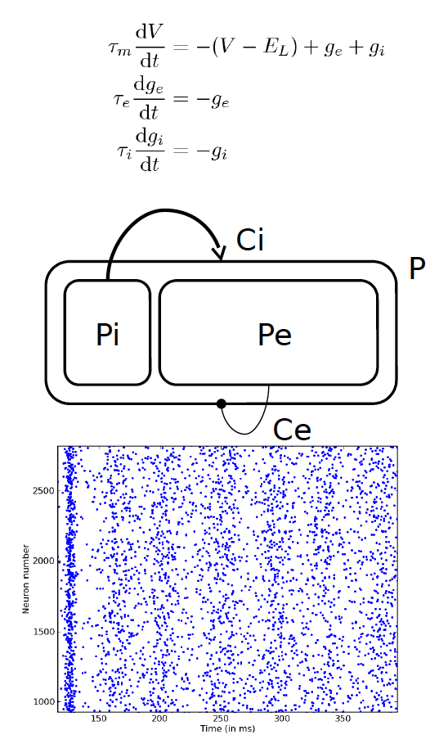
An example
Stimberg M, Goodman DFM, Benichoux V, Brette R (2014).Equation-oriented specification of neural models for simulations. Frontiers Neuroinf, doi: 10.3389/fninf.2014.00006.

Slide 12
Example: synaptic plasticity
Stimberg M, Goodman DFM, Benichoux V, Brette R (2014).Equation-oriented specification of neural models for simulations. Frontiers Neuroinf, doi: 10.3389/fninf.2014.00006
Notes:
Units and names are specified
Equations are given directly in math form
Threshold conditions are mathematical conditions
Reset is a statement in mathematical form
State variables can be initialized with mathematical expressions
We keep full expressivity with programmatic modeling
Synapses are also specified by equations and statements

Slide 13
Problem #2: speed & hardware

Slide 14
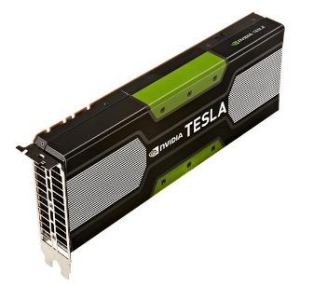
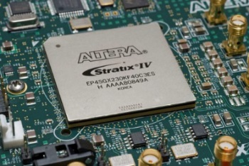
Brian code generation
User provided Python code
Targets
GPU
Spinnaker
PC
FPGA
Android
smartphone
Automatically generated code

Slide 15
Code generation

Slide 16
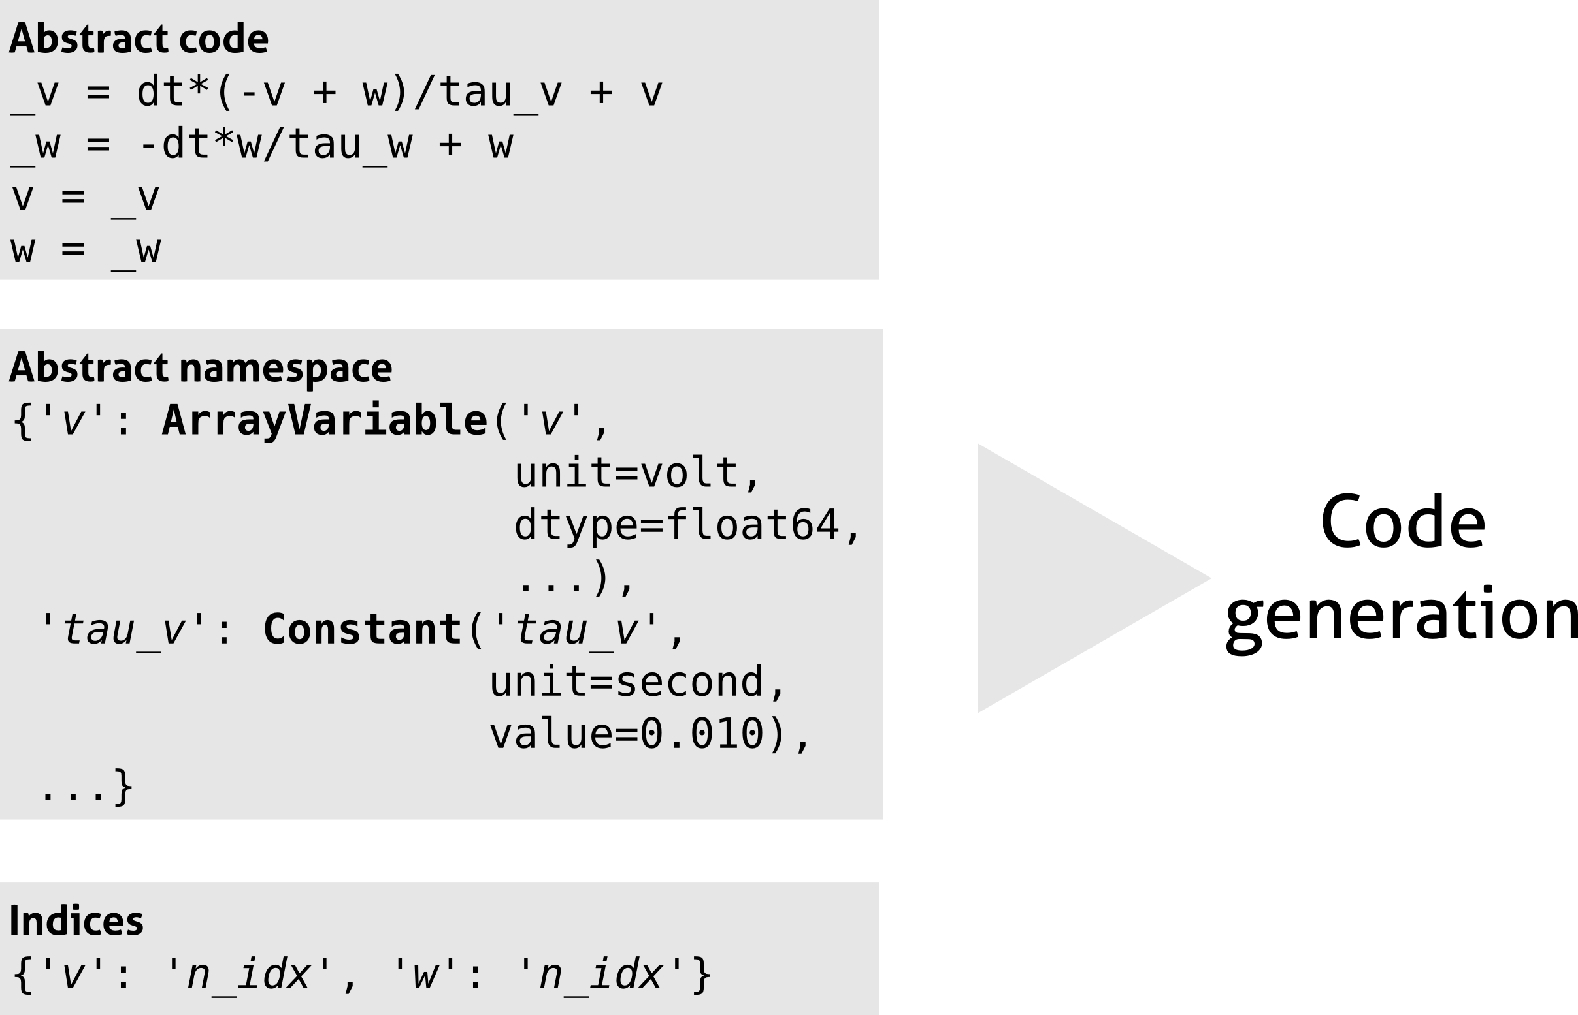
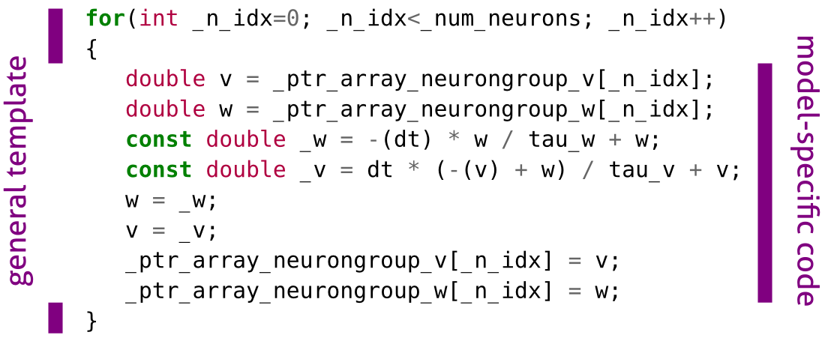
Code generation
Notes:
All that is target-independent

Slide 17
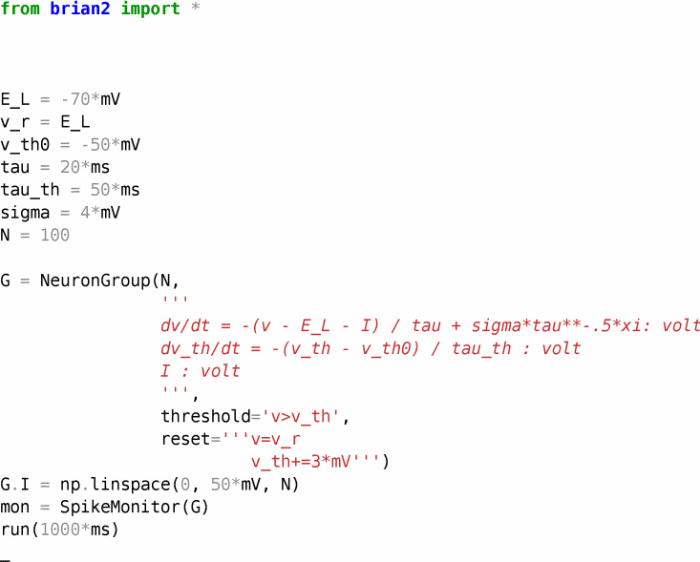
Brian runtime mode

Slide 18
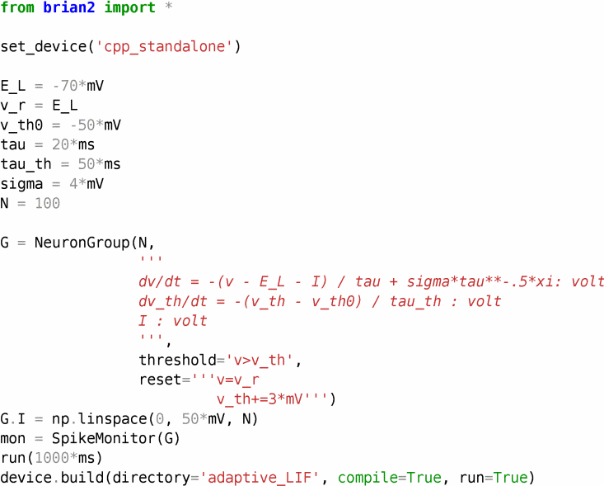
Brian standalone mode

Slide 19
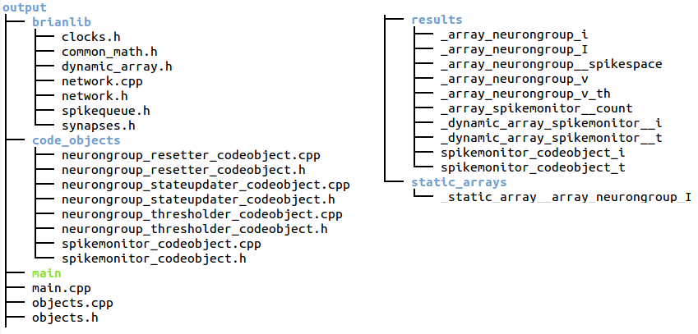
Brian standalone mode
Generated files

Slide 20
The future of
Implementation of various targets
GPU
Spinnaker
PC clusters
FPGA
Android
smartphone
Notes:
Multicore (not clusters MPI) > Pierre (OpenMP)
GPU:
interface with GeNN (Thomas Nowotny) – no plasticity. Runs without plasticity.
CUDA being done by a student in Berlin (Moritz Augustin)
Spinnaker: just discussions for now
FPGA: nothing
Android: proof of concept (google SoC)

Slide 21
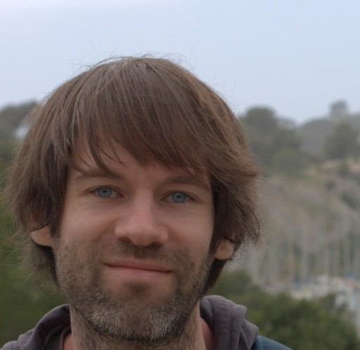
Thank you!
http://briansimulator.org
romain.brette@inserm.fr
Dan Goodman
Marcel Stimberg
Latest publication
Stimberg M, Goodman DFM, Benichoux V, Brette R (2014).Equation-oriented specification of neural models for simulations. Frontiers Neuroinf, doi: 10.3389/fninf.2014.00006.

