Slide 1
Philosophy of the spike
Romain Brette
Ecole Normale Supérieure, Paris
romain.brette@ens.fr

Slide 2
The question
Is neural computation based on spikes or on firing rates?
RATES
SPIKES
Goal of this talk: to understand the question!

Slide 3
Three statements I have heard
“Both rate and spike timing are important for coding, so the truth is in between”
“Neural responses are variable in vivo, therefore neural codes can only be based on rates”
“A stochastic spike-based theory is nothing else than a rate-based theory, only at a finer timescale”

Slide 4
“Both rate and spike timing are important for coding, so the truth is in between”

Slide 5
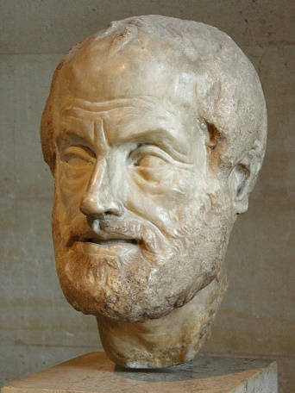
“Both rate and spike timing are important for coding, so the truth is in between”
The « golden mean »: between two extreme positions, an intermediate one must be true.
a.k.a. « the golden mean fallacy »
Aristotle
Extreme Position A: there is a God
Extreme Position B: there is no God
=> there is half a God!
Are rate-based and spike-based views two extreme positions of the same nature?

Slide 6
Of spikes and rates
Spikes: a well-defined timed event, the basis of neural interaction
Rates: an abstract concept defined on spikes
e.g. temporal or spatial average (defined in a large N limit);
probabilistic expectation.
Rate-based postulate: this concept/approximation captures everything relevant about neural activity
Spike-based view: this postulate is not correct
This does not mean that « rate » is irrelevant!
dt

Slide 7
Rate in spike-based theories
Spike-based computation requires spikes
More spikes, more computation
Therefore, firing rate determines quantity of information
Spike-based view: rate determines quantity of information
Rate-based view: rate determines content of information

Slide 8
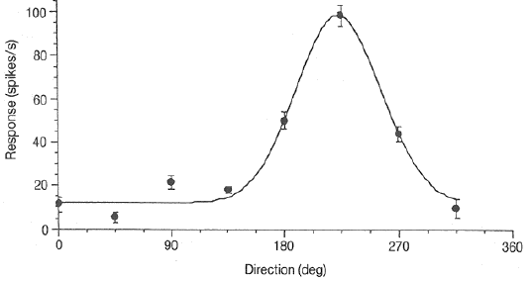
The tuning curve
Firing rate varies with stimulus properties
(rate-based)
Firing rate « encodes » direction
or:
(spike-based)
The neuron spends more energy at the « preferred » direction
(rate is a correlate of computation)
The question is not: « is firing rate or spike timing more informative/useful? »
but: « which one is the basis of computation? »

Slide 9
“Both rate and spike timing are important for coding, so the truth is in between”
Spike-based view: rate determines quantity of information
Rate-based view: rate determines content of information

Slide 10
“Neural responses are variable in vivo, therefore neural codes can only be based on rates”

Slide 11
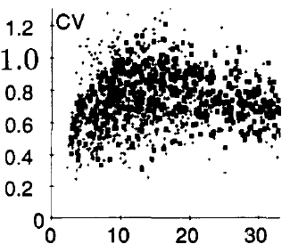
Neural variability
Temporal irregularity
rate (Hz), V1
ISI
Close to Poisson statistics
Rate-based view: spike trains have Poisson statistics (ad hoc hypothesis)
Spike-based view: spike trains have Poisson statistics (maximum information)
Lack of reproducibility
- empirically questionable
- could result from uncontrolled variable
But let’s assume it’s true and examine the argument!

Slide 12
No reproducibility => rate-based?
lack of reproducibility => either stochastic or chaotic
This is about stochastic/chaotic vs. deterministic,
not about rate-based vs. spike-based
Implicit logic
responses of N neurons are irreproducible => there exist N dynamic quantities that
completely characterize the state of the system and its evolution
determine the probability of firing of the neurons
This is pure speculation!

Slide 13
A counter-example
Sparse coding
Imagine you want to code this signal:
with the spike trains of N neurons, so that you can reconstruct the signal by summing the PSPs
$$S\left(t\right)≈\sum_{i,j}{PSP(t−t_{i}^{j})}$$
(with a given rate)
The problem is degenerate, so there are many solutions.
For example this one:
Or this one:

Slide 14
A counter-example
$$S\left(t\right)≈\sum_{i,j}{PSP(t−t_{i}^{j})}$$
The problem is degenerate, so there are many solutions.
For example this one:
Or this one:
It is variable
It cannot be reduced to rates, because error is in 1/N, not 1/$√$N

Slide 15
The argument strikes back
Do rate-based theories account for neural variability?
Rate-based theories are deterministic
Deterministic description is obtained by averaging, a.k.a. removing variability
Rate-based theories do not account for neural variability,
they acknowledge that there is neural variability
To account for variability of spike trains requires spikes,
i.e., a stochastic/chaotic spike-based theory

Slide 16
“Neural responses are variable in vivo, therefore neural codes can only be based on rates”
Rate-based theories do not account for neural variability,
they acknowledge that there is neural variability, and postulate that it is irrelevant (averaging)
To account for variability of spike trains requires spikes,
i.e., a stochastic/chaotic spike-based theory

Slide 17
“A stochastic spike-based theory is nothing else than a rate-based theory, only at a finer timescale”

Slide 18
“A stochastic spike-based theory is nothing else than a rate-based theory, only at a finer timescale”
spikes
In terms of stimulus-response properties, there is about the same information in the time-varying rate
rate
Rate-based postulate:
for each neuron, there exists a private quantity r(t) whose evolution only depends on the other quantities r_{i}(t).
spike trains are derived from r(t) only
r₁
stochastic
r₂
r = f(r₁, r₂, r_{n})
It is assumed that this is approximately the same for all realizations
r_{n}

Slide 19
“A stochastic spike-based theory is nothing else than a rate-based theory, only at a finer timescale”
Rate-based postulate:
for each neuron, there exists a private quantity r(t) whose evolution only depends on the other quantities r_{i}(t).
spike trains are derived from r(t) only
r₁
stochastic
r₂
r = f(r₁, r₂, r_{n})
It is assumed that this is approximately the same for all realizations
r_{n}
Implication: spike trains are realizations of independent random processes, with a source of stochasticity entirely intrinsic to the neuron.
This has nothing to with the timescale!

Slide 20
Reformulating the question

Slide 21
Is neural computation based on spikes or on firing rates?
Can neural activity and computation be entirely and consistently described by the dynamics of time-varying rates in the network?
Spelling out the rate-based postulate
for each neuron, there exists a private quantity r(t) whose evolution only depends on the other quantities r_{i}(t).
r_{i}(t) is the expected firing probability of neuron i.
spike trains (realizations) depend on r(t) only, through a private stochastic process (independent neurons)

Slide 22
Spelling out the rate-based postulate
for each neuron, there exists a private quantity r(t) whose evolution only depends on the other quantities r_{i}(t).
r_{i}(t) is the expected firing probability of neuron i.
spike trains (realizations) depend on r(t) only, through a private stochastic process (independent neurons)
Example 1: random networks
If true, then r_{i}(t) can be found by writing self-consistent equations
(cf. Brunel)
This works for sparse random networks, but not in general.
Example 2: sparse coding
$$S\left(t\right)≈\sum_{i,j}{PSP(t−t_{i}^{j})}$$
Signal reconstruction is more accurate than with rates

Slide 23
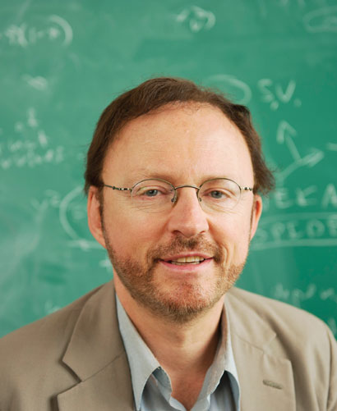
Marr’s three levels
The three levels of analysis of an information-processing system:
Computational level
Algorithmic/representational level
Physical level
Marr (1982) Vision. MIT Press
« Rate-based computation » is the postulate that levels #2 and #3 are independent
The postulate is methodological (convenient), not based on either evidence or reasoning
Notes:
Definition in a very broad sense.
Example: where does the sound come from.
A classical representationalist. Action is disconnected from perception.

Slide 24
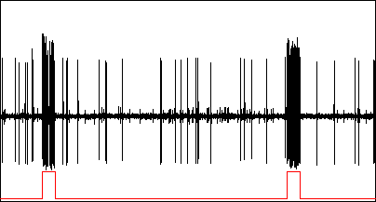
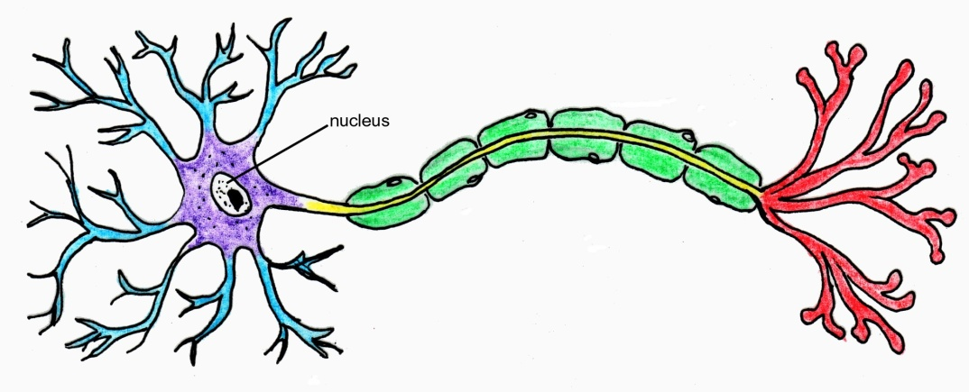
Neurons: actors or observers?
The coding metaphor
The acting metaphor
The neuron acts on its environment
Notes:
Neural representations in the mind of the observer.

Slide 25
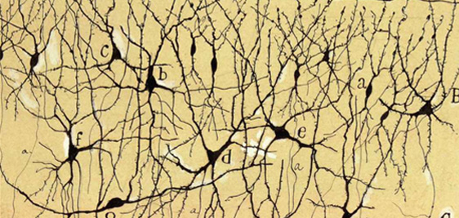
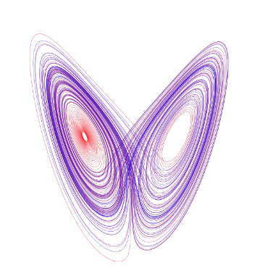
The chaos argument
“Neural networks are chaotic, therefore neural codes can only be based on rates”
(a special case of the variability argument)
A number of dynamical variables:
v₁, v₂, v_{n}...
Their exact evolution is unpredictable
=> same as random variables
Main problem: chaos is deterministic
Lorenz attractor

Slide 26
The chaos argument transposed to climate
Climate equations are chaotic, therefore one can replace the variables by random variables without loss
Wrong:
1) In the Lorenz equations, the variables are still constrained to a deterministic set (the Lorenz attractor)
2) You can make short-term predictions that are better than seasonal means

