Slide 1

Neural geometry and excitability
Romain Brette
romain.brette@inserm.fr

Slide 2
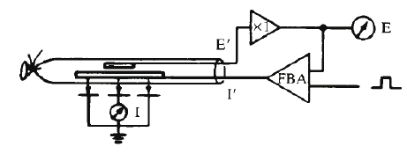
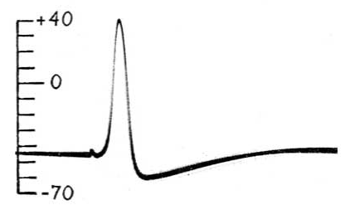


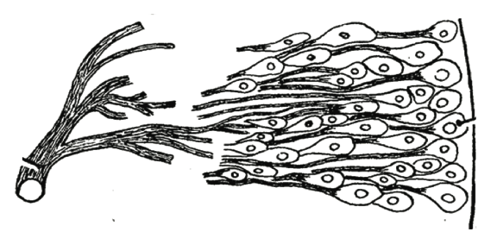
Classic theory of excitability
Na+
Na⁺
K⁺
K+
The squid giant axon
A model of excitation of a homogeneous membrane
Hodgkin & Huxley
(Nobel prize 1963)
axon
cell bodies

Slide 3
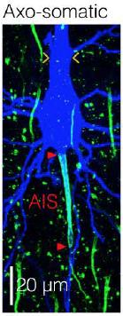
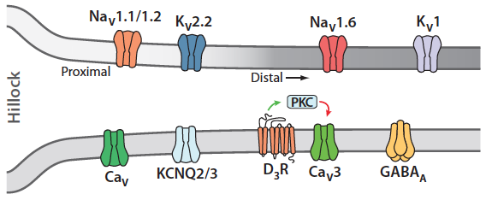
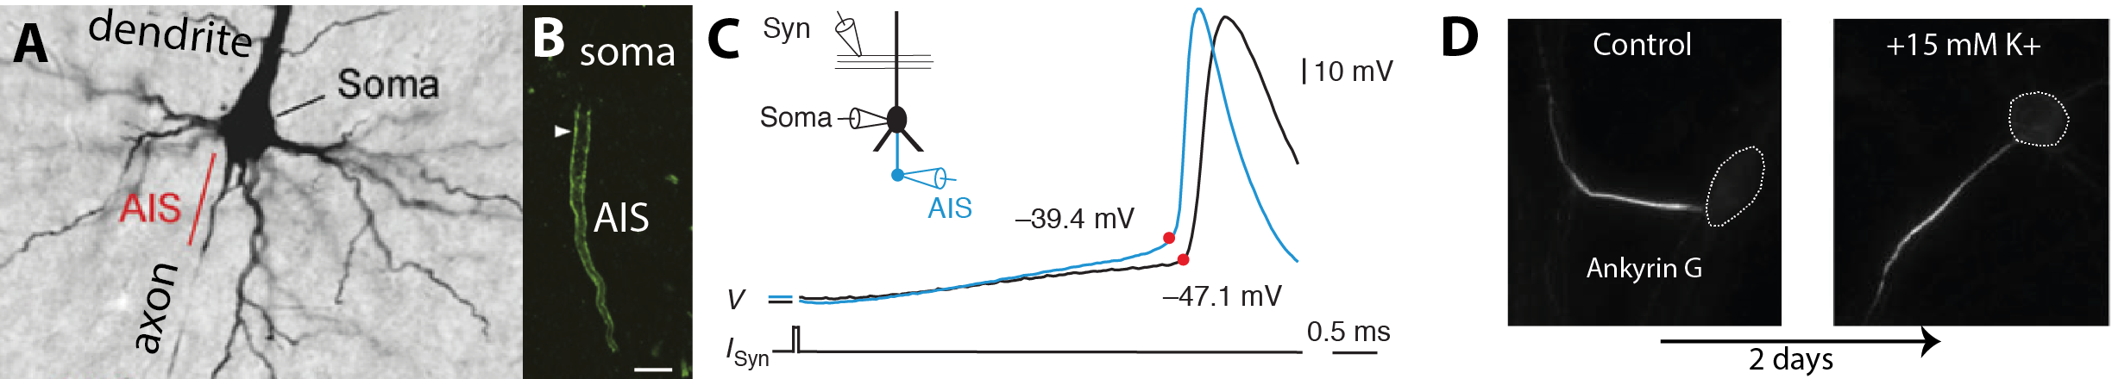
Geometry of spike initiation in neurons
soma
AIS
Kole & Stuart (2008)
~ 40 µm
AIS geometry is plastic
Hamada et al.
(2016)
Grubb & Burrone (2010)
Notes:
What is different about spike initiation in neurons is not the ionic basis but the geometry of the system. Synaptic currents coming from the dendrites are collected at the soma, which increases the potential of the soma and neighboring regions, including a small structure in the axon near the soma called the axonal initial segment, a few tens of µm long. That region is packed with ionic channels, in particular Na+ channels, and this is where the action potential first occurs, before it is seen in the soma, where the spike is actively regenerated by local channels and spreads to the dendrites. Electrically this region is very small because the characteristic distance of passive voltage attenuation is several hundred µm. So this is an electrical system characterized by a discontinuity in the geometry and distribution of channels, quite unlike the squid giant axon. Recently it has been found that the both the position and length of this initial segment varies with activity. It also varies between cells, with development, and with diseases.

Slide 4
Geometry of spike initiation in neurons
What is the impact of geometry on excitability?
on spike initiation
on spike transmission to soma
Notes:
What is the impact of geometry on excitability ? How does it impact the initiation of spikes, in particular the threshold ? How does it impact the transmission of the spike to the big soma ? How does it impact the flow of ions, which determines energy consumption ? These are the main questions we want to answer in this project.

Slide 5
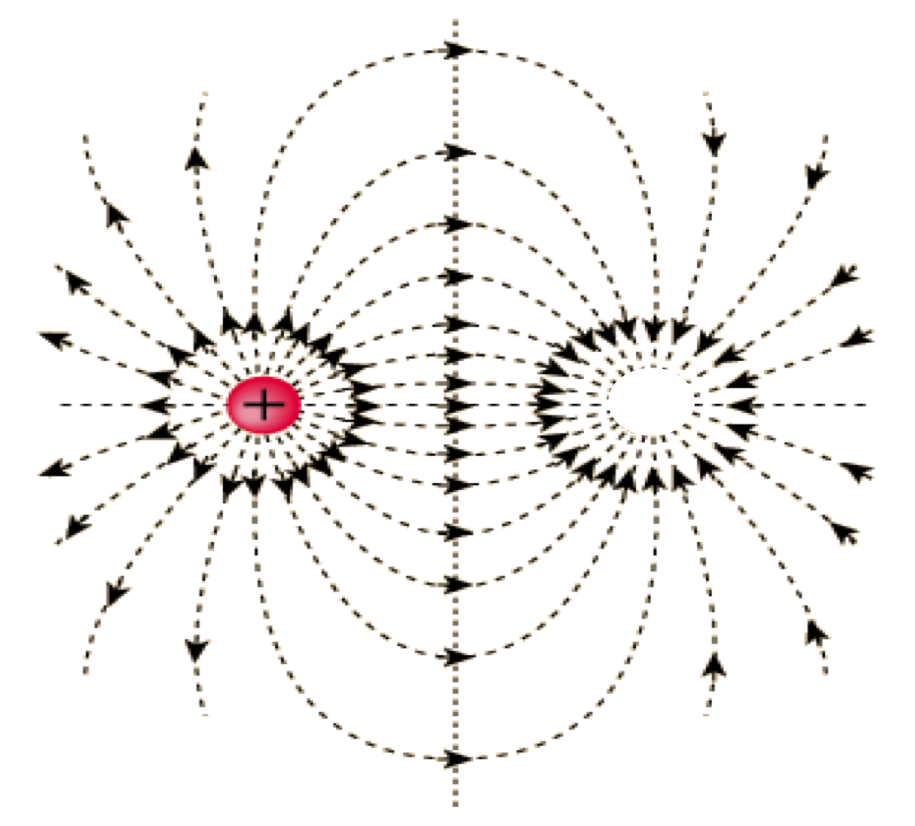
Resistive coupling theory in a nutshell
1. Spike initiation
resistive
capacitive
resistive = Na+
v
~ d²/x
~ exp(V/k)
resistive
Na+
d
x
v
AIS
2. Spike transmission
resistive = capacitive
soma
~ d²/x
~ soma area . dV/dt
Notes:
The initial approach I have taken is to model the soma and AIS as a dipole. At spike initiation, a current loop forms where current enters the axon carried by Na+, flows resistively towards the soma, and escapes as capacitive current. From this simple model, we can get a sense of the impact of geometry on electrical properties, in particular on the threshold for spike initiation. The resistive current should be proportional to the section area of the axon and inversely proportional to the distance of the initiation site from the soma. The Na+ current is an exponential function of voltage. From this, we deduce a logarithmic dependence between threshold and these geometrical parameters. In the same way, for the transmission to the soma, the capacitive current is proportional to the membrane area of the soma and dendrites, and for an action potential of given shape, the distance of the initial segment should be inversely proportional to the area of the soma.
This is a good start but of course the initial segment is not a point. So we will need to analyze spike initiation and spike transmission in spatially extended models based on cable theory, using separation of time scales to obtain analytical formulae. We will also analyze the effect of channels at the initial segment on excitability.
Finally, in contrast with homogeneous axons, there are significant ion flows in the axial direction, for example Na+ flowing to the soma at initiation. Cable theory only includes axial currents due to the electrical field but not to diffusion and so we will look at an extended version of cable theory. From this analysis, we will derive the total influx of ions due to action potentials, which determines energy consumption. And finally, this will allow us to deduce the optimal properties of the initial segment for minimum energy consumption.

Slide 6
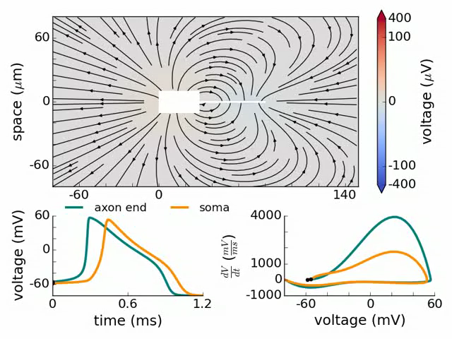
Resistive coupling theory in a nutshell
Simulation of a detailed model
(Yu et al. 2008)
Teleńczuk M, Fontaine B, Brette R (2016). The basis of sharp spike onset in standard biophysical models.

Slide 7
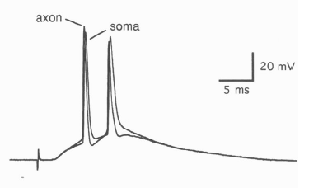
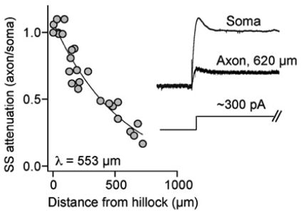
Spike initiation in the AIS
AIS
Most of the time, Vm is the same in soma and AIS
Stuart, Schiller, Sakmann (J Physiol 1997)
Kole, Letzkus, Stuart (Neuron 2007)
I_{Na}
x ≈ 30 µm
conductance ratio: λ/x ≈ 15
soma = « current sink »
soma
Ra = x.ra
Ra = λ.ra
Brette, R. (2013). Sharpness of spike initiation in neurons explained by compartmentalization.

Slide 8
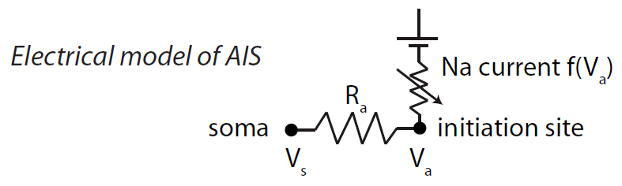
Spike initiation in the AIS
I_{Na}
x ≈ 30 µm
conductance ratio: λ/x ≈ 15
soma = « current sink »
soma
Ra = x.ra
Ra = λ.ra
Brette, R. (2013). Sharpness of spike initiation in neurons explained by compartmentalization.

Slide 9
Effect of channel location
I
The soma is a current sink
soma
V_{a}
R_{a}.I
V_{s}
(Ohm’s law)

Slide 10
Effect of channel location
I
The soma is a current sink
soma
V_{a}
R_{a}.I
(Ohm’s law)
V_{s}

Slide 11
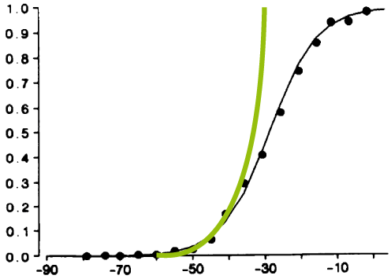
Resistive current = Na+ current
Na activation
I=f(V_{a})
soma
V_{a}
R_{a}.I
V_{s}

Slide 12
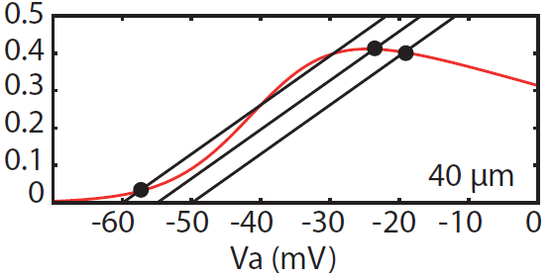
Resistive current = Na+ current
I=f(V_{a})
I=(V_{a}-V_{s})/Ra
Lateral and Na currents must match
soma
V_{s}
V_{s}
I=f(V_{a})
I (nA)
I=(V_{a}-V_{s})/Ra
Bifurcation! = abrupt opening of Na channels
Notes:
COLOR CODES!!!!

Slide 13
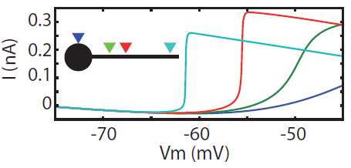
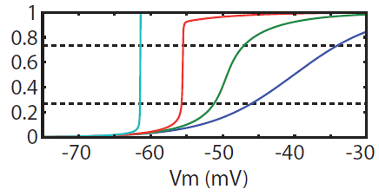
A view from the soma
Lateral current flows abruptly when a voltage threshold is exceeded
m
Na channels open in an all-or-none fashion
« sharp initiation »

Slide 14
A view from the soma
A fairly good phenomenological description:
below V_{t}, no sodium current
when Vm reaches V_{t}: all channels open (spike)
a.k.a. the integrate-and-fire model !
with axonal initiation
single compartment HH model
V_{t}
m
Brette R (2015). What Is the Most Realistic Single-Compartment Model of Spike Initiation?

Slide 15
The threshold equation
Fixed point equation
f(V_{a}) = (V_{a}-V_{s})/Ra
I (nA)
Spike threshold = bifurcation point
(= V_{s} when solution jumps)
Na activation
The threshold equation
k_{a}
V_{1/2}
Notes:
A small correction actually

Slide 16
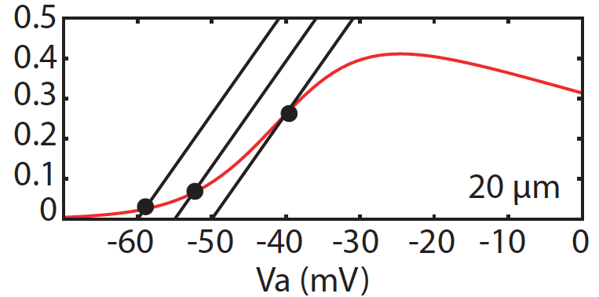
The sharpness condition
V_{s}
V_{s}
V_{s}
V_{s}
I=f(V_{a})
I=f(V_{a})
I (nA)
I=(V_{a}-V_{s})/Ra
I (nA)
I=(V_{a}-V_{s})/Ra
not sharp
sharp
Critical point: f’(V_{1/2}) = 1/R_{a}
Roughly: R_{a}.g_{Na} > 0.27

Slide 17
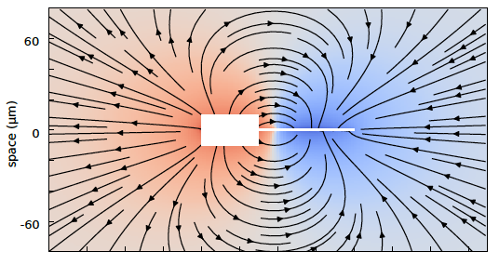
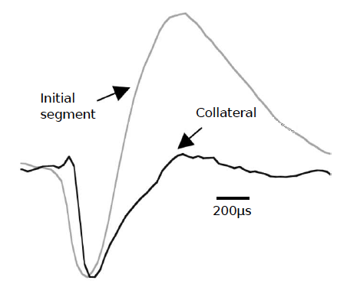
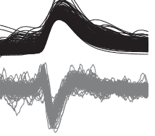
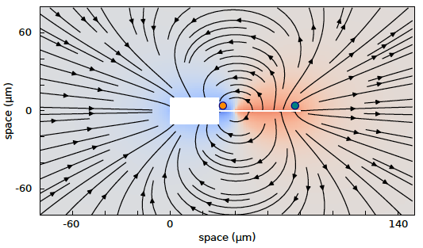
Experimental evidence
1) Dipole formation
depolarization
Ve AIS
Vm soma
Palmer and Stuart (J Neurosci 2006)
repolarization
Chorev & Brecht (J Neurophy 2012)
Ve soma
Teleńczuk M, Fontaine B, Brette R (2016). The basis of sharp spike onset in standard biophysical models.
Notes:
Hippocampal neurons

Slide 18
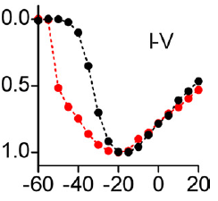
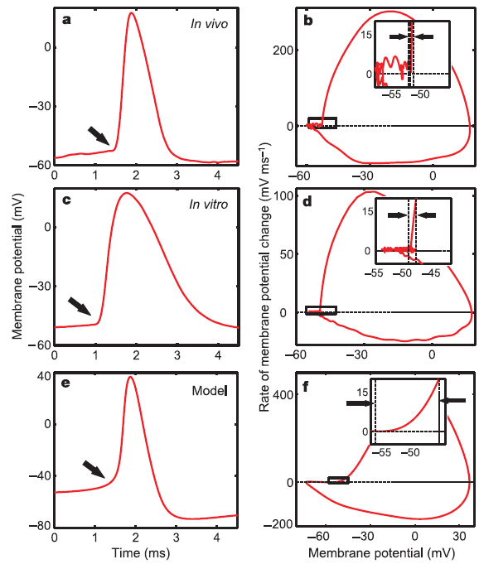
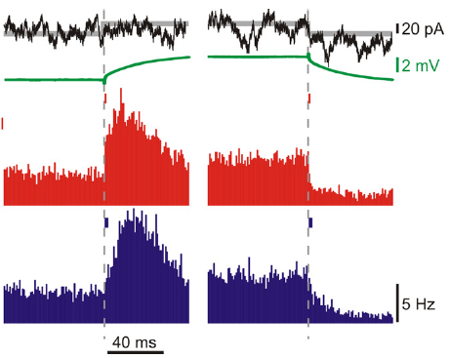
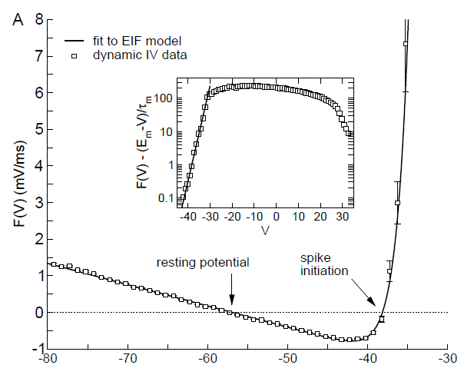
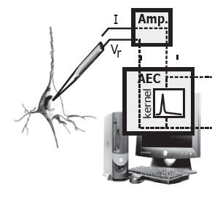
Experimental evidence
2) Sharp spike initiation
Somatic voltage-clamp recordings of Na current
Sharp spike onsets
Fast response to current changes,
as in integrate-and-fire models!
Axonal Na channels inactivated
Milescu, Bean, Smith (2010)
Sharp I-V relationship at soma
Ilin et al. (2013)
V
Naundorf, Wolf, Volgushev (2006)
Badel et al. (2008)

Slide 19
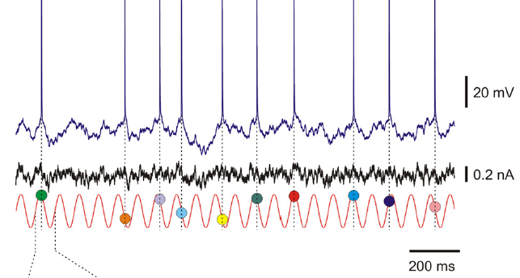
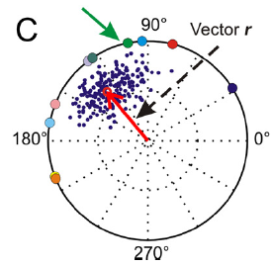
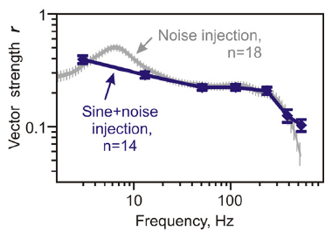
Experimental evidence
2) Sharp spike initiation
Fast response to current changes,
as in integrate-and-fire models!
Brunel et al. (PRL 2001)
Ilin et al. (J Neurosci 2013)
Transmission of high frequency inputs
Ilin et al. (J Neurosci 2013)

Slide 20
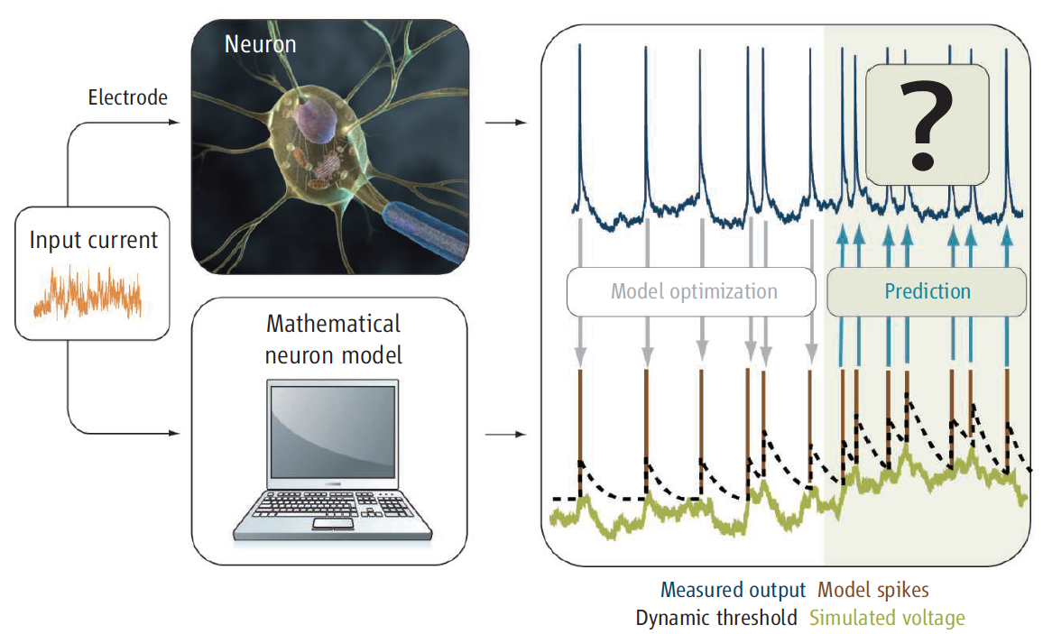
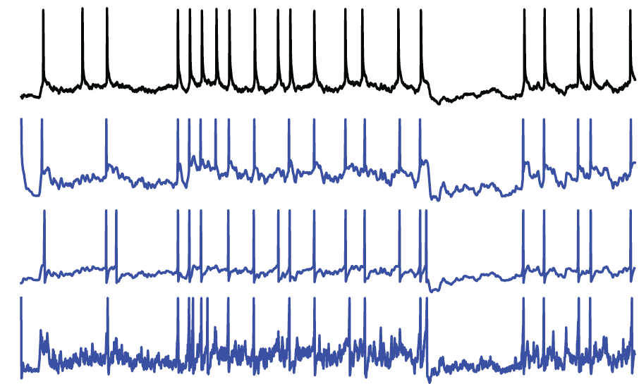
Experimental evidence
2) Sharp spike initiation
The INCF competition
cortical neuron
MAT2 (86%)
AIF (84%)
Izhikevich (62%)
Rossant et al. (Frontiers Neurosci 2011)
Gerstner & Naud (Science 2009)
Best fit of adaptive exponential model:
= 0 mV
=IF model
Integrate-and-fire models can predict spike times of real neurons

Slide 21
Experimental evidence
3) Somatic voltage-clamp
Saddle-node bifurcation:
- stereotypical current spikes
- hyperbolic voltage-dependent latency
Milescu et al (2010)

Slide 22
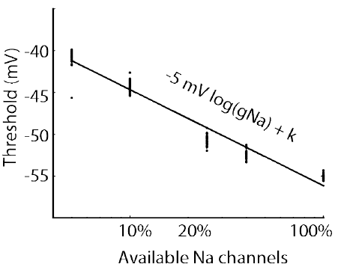
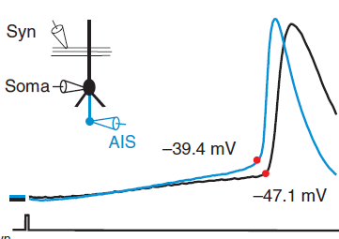
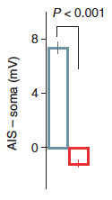
Experimental evidence
3) Threshold
The threshold equation
Axonal threshold
V_{a} = V_{s} + k_{a}
(Fekete and Debanne, preliminary data)
Kole & Stuart (2008)

Slide 23
Experimental evidence
4) Threshold
The threshold equation
Pinching
(Fekete and Debanne, preliminary data)

Slide 24
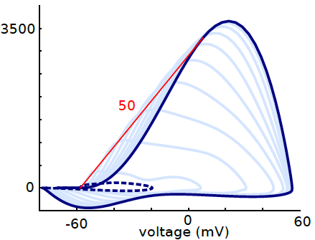
Experimental evidence
5) Onset rapidness
Onset rapidness at soma = maximum rapidness at AIS
Onset rapidness at AIS = (1/ka).dVa/dt
soma
Teleńczuk M, Fontaine B, Brette R (2016). The basis of sharp spike onset in standard biophysical models.
AIS
max slope ≈ 23 ms⁻¹
Yu et al. (J Neurosci 2008)

Slide 25
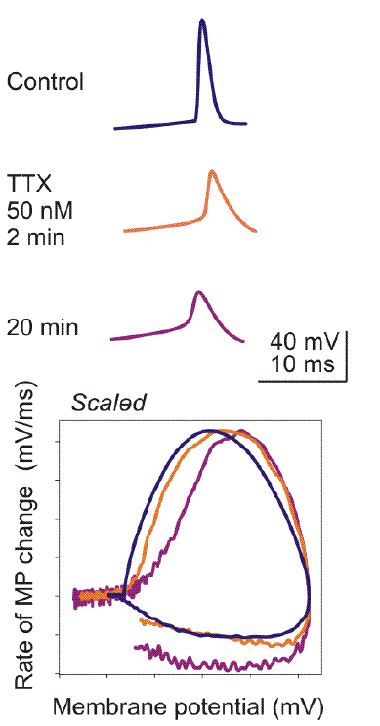
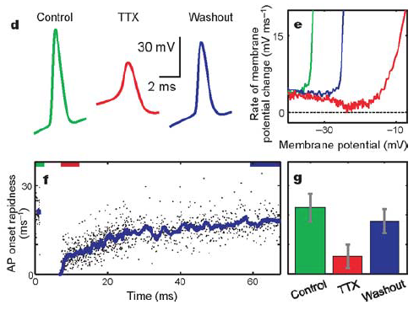
Experimental evidence
6) Sharpness condition
R_{a}.g_{Na} > 0.27
Naundorf et al. (Nature 2006)
Volgushev et al.
(2007; unpublished)
Notes:
hard to interpret however

Slide 26
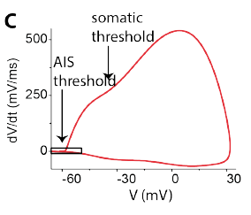
Spike transmission to the soma
Yu et al. (2008)
The AIS charges the soma

Slide 27
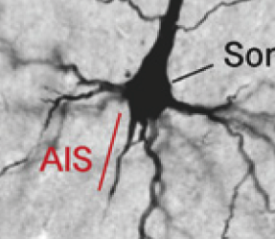
Resistive coupling theory, part 2
Theory: resistive current (axon) = capacitive current
capacitive
resistive
x
Resistive current = 1/R ~ 1/x
Capacitive current ~ somatodendritic area . dV/dt
Conclusion (for a spike of fixed shape):
x ~ 1/somatodendritic area
A big neuron must have a proximal AIS

Slide 28
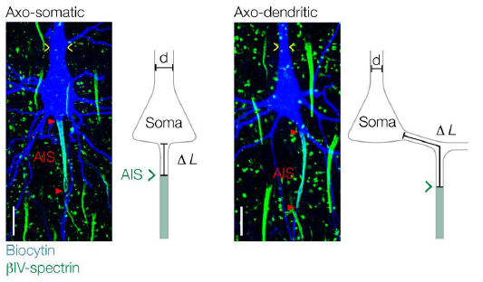
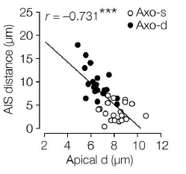
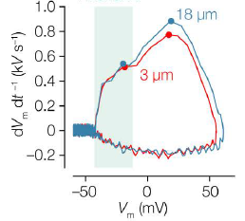
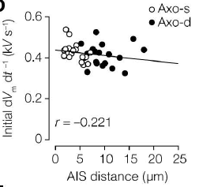
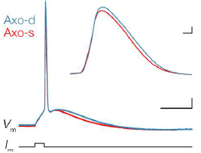
Neuron size vs. AIS position
Big neuron => proximal AIS
Initial AP shape is normalized
Hamada, Goethals, de Vries, Brette, Kole (PNAS 2016). Covariation of axon initial segment location and dendritic tree normalizes the somatic action potential.

Slide 29
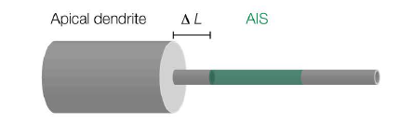
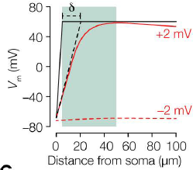

Resistive coupling theory
We neglect inactivation etc
clamped at threshold
resistive
all channels open
Rough approximation: I = (E_{Na} – V_{threshold}) / (r_{a}.Δ)
More precisely
Result:
with

Slide 30
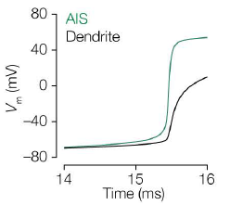
Resistive coupling theory
Voltage response of a cylindrical cable (Rall):
Normalized voltage response =>

Slide 31
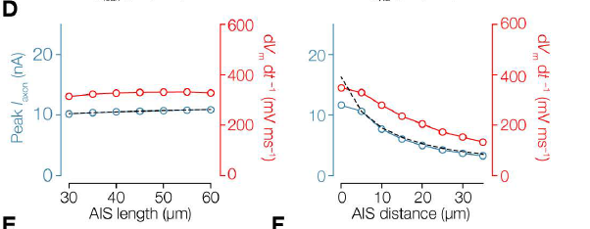
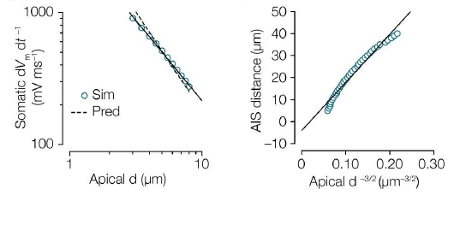
Theory vs. simulation
Current and voltage response depend on AIS distance, not length
Voltage response vs. diameter
AIS distance for normalized response

Slide 32
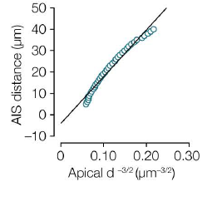
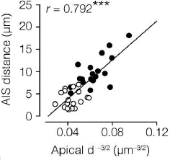
Theory vs. experiment

Slide 33
Summary: resistive coupling theory
1. Spike initiation
resistive
capacitive
resistive = Na+
v
~ d²/x
~ exp(V/k)
resistive
Na+
d
x
v
AIS
Sharp initiation
soma
Threshold equation
2. Spike transmission
resistive = capacitive
co-tuning of AIS distance and neuron size
~ d²/x
~ soma area . dV/dt

Slide 34










Perspective: experimental system
Difficulty: non-reproducible 3D branched geometry
Solution:
cultured neurons with controlled geometry
AIS
volume measurement by fluorescence exclusion
AIS manipulation
z (µm)
axonal measurement methods
dynamic manipulation of geometry
v
v
node
v
v
AIS
switchable pattern
soma
Notes:
Experimentally, a big challenge is that neurons normally have non-reproducible 3D branched geometry. It is possible to test some theoretical predictions with limited precision, but it is clearly not an ideal setting to develop the theory as we have no control on the geometry.
To solve this difficulty, we will use an experimental system to culture neurons with constrained geometry. Neurons are cultured on coverslips on which patterns of adhesive substrates have been printed, so that neurons as they grow take the form we have imposed. We know from preliminary work that these neurons have normal electrophysiological and molecular properties, including the initial segment. However, the vertical dimension is not constrained. To measure it we will use a microfluidic chamber of known height to deduce the vertical dimension of the neuron from a fluorescent signal.
With this system we will use a number of tools to test the theory : patch-clamp electrophysiology to measure currents and membrane potential, immunochemistry to measure the geometry of the initial segment and channel density, pharmacology to block or manipulate channels, manipulation of the culture medium to induce long-term displacements of the initial segment.
Another technical issue is that patch clamp electrophysiology is difficult in the axon because of its small size, although it can be done with a small yield. We will try two ideas to solve it : one is to enlarge the axon after the initial segment, as shown on this image, so that we can patch at the beginning of the enlargement. Another is to make local enlargements as shown here, which we have already observed by accident ; we think the neuron will remain functional because a similar technique has been successfully used in slices where a swelling forms due to the slicing.
Finally, we will also develop a technique to change geometry dynamically, that is, after the neuron has grown. It consists in using patterns that can be chemically switched on at a later time.
These more advanced developments have high added value but they are also risky because we don't know yet how the neuron will adapt to these manipulations. However many experiments can still be done without them, so it is not critical.

Slide 35







Thank you
Maria Teleńczuk
Jonathan Platkiewicz
Maarten Kole
Sarah Goethals
Dominique Debanne
Catherine Villard
Bertrand Fontaine
Hamada M, Goethals S, de Vries S, Brette R, Kole M (2016). Covariation of axon initial segment location and dendritic tree normalizes the somatic action potential.
Teleńczuk M, Fontaine B, Brette R (2016). The basis of sharp spike onset in standard biophysical models.
Brette R (2015). What Is the Most Realistic Single-Compartment Model of Spike Initiation?
Brette R (2013). Sharpness of spike initiation in neurons explained by compartmentalization.
Platkiewicz J, Brette R (2011). Impact of Fast Sodium Channel Inactivation on Spike Threshold Dynamics and Synaptic Integration.
Platkiewicz J, Brette R (2010) A Threshold Equation for Action Potential Initiation.

