Slide 1

What can be learned from a connectome?
Romain Brette
romain.brette@inserm.fr

Slide 2

Sebastian Seung
Notes:
That’s in the connectome book. What Seung expresses here is the connectionnism doctrine.

Slide 3
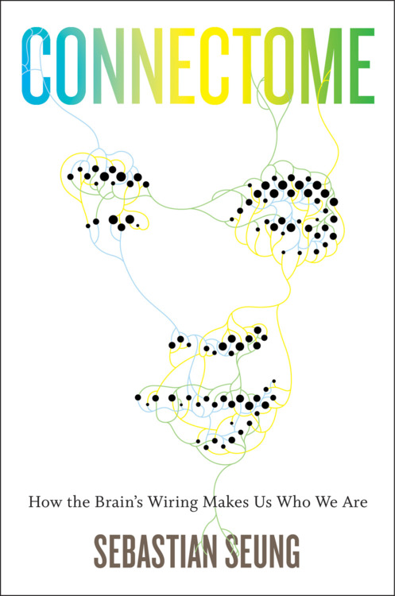
Connectionism
« I am my connectome » Seung, « Connectome »
« It might not be so unrealistic to hope that in staring into such a map we might get a glimpse of the human mind”
Why not connectomics? (2013) Morgan & Lichtman
“Moving beyond the brain’s algorithms, connectomics may ultimately allow us to read memories if, as many neuroscientists believe, memory is stored in the pattern of synaptic connections and strengths.”
Structural neurobiology: missing link to a mechanistic understanding of neural computation (2012) Denk, Briggman & Helmstaedter
Wikipedia: Connectionism [..] models mental or behavioral phenomena as the emergent processes of interconnected networks of simple units.

Slide 4
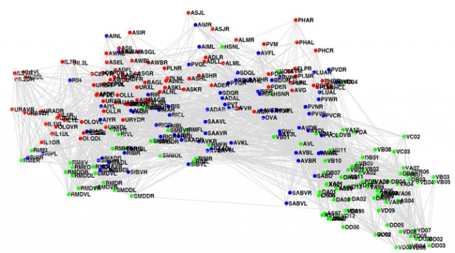
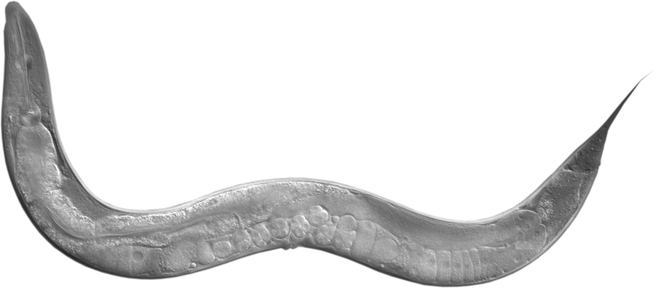
Known connectomes
C. Elegans
« The worm connectome may not be as useful as initially imagined because of its surprising complexity. »
(Why not connectomics? Morgan & Lichtman)
« each neuron has many subcellular compartments »
Notes:
White et al (1986)
Some technical aspects (inhibitory/excitatory)
What makes us think that it would be so for mammals?

Slide 5
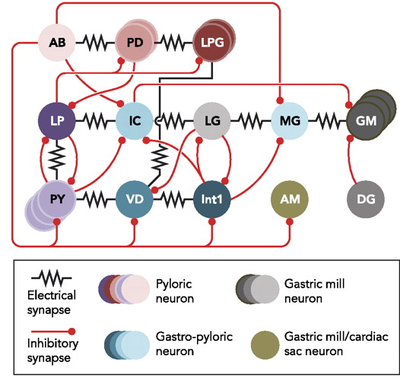

Known connectomes
Crustacean stomatogastric ganglion
Hudson et al. (2010)
Same structure => many functions
depending on neuromodulation
Brezina (2010) Beyond the wiring diagram
Marder & Bucher (2001)
Notes:
Whether there is neuromodulation or not, this exemplifies the fact that connectivity structure does not constrain function.

Slide 6

Donald Rumsfeld, US Secretary of Defense
Notes:
Donald Rumsfeld

Slide 7
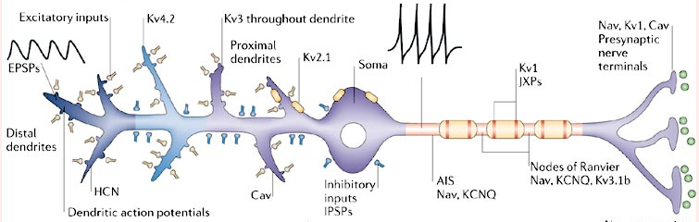
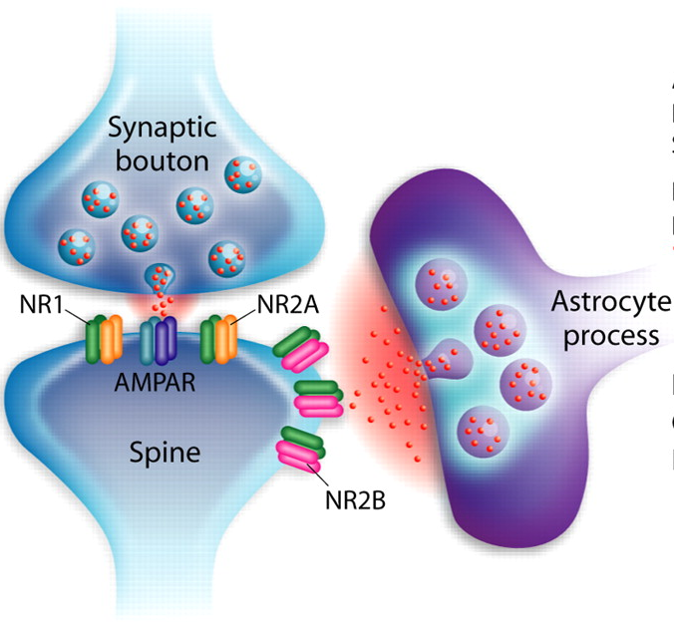
Beyond the connectome
nonlinearities
intrinsic plasticity
synaptic dynamics
neuromodulation
spill-over
ephaptic interactions
AIS is a separate plastic compartment
neuron-glia coupling
+ unknown unknowns
Notes:
STP: means that synaptic strength is dynamic and inaccessible from purely structural data.
Some can be saved, some will remain hidden variables
Known unknowns: there is little data on those but we know they exist;
+ neuromodulation of axonal transmission (not necessarily synaptic)
So the connectionist doctrine is questionable: basically connectivity says little about function; it does say something when there is no connection, but even there can be non-synaptic communication.

Slide 8
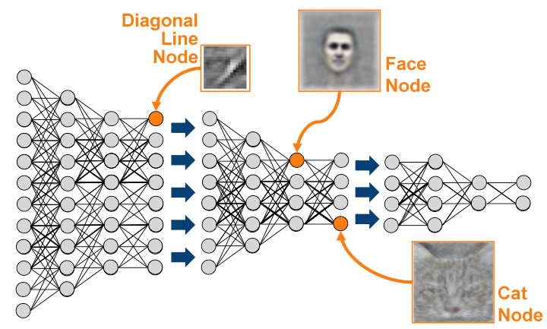
Distinguishing between neural network theories
Synfire chains (Abeles)
Deep learning
(Diesmann et al, Nature 1999)
Embedded synfire chains
Vogels & Abbott (2005)
Notes:
Maybe then connectome can help distinguish between theories of brain function?
basic point: differences are functional, not anatomical

Slide 9
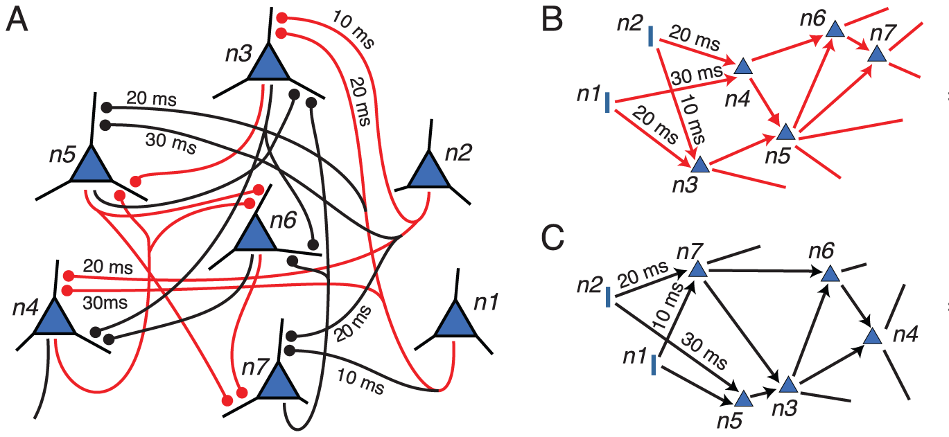
Distinguishing between neural network theories
Polychronization (Izhikevich)
Attractor networks
(Laje & Buonomano 2013)
(Szatmary and Izhikevich 2010)
Liquid state machines
Predictive coding
(Boerlin et al. 2013)
Notes:
+ dynamicism
basic point: differences are functional, not anatomical

Slide 10
Distinguishing between neural network theories
Polychronization (Izhikevich)
Rate-based theories
(Szatmary and Izhikevich 2010)
(Shadlen & Newsome 1998)
Predictive coding
Normative theories do not make strong assumptions about connectivity
(Boerlin et al. 2013)
Notes:
Bottomline: differences are not connectivity. Rather: function and learning rules.
Many important theories of brain function are normative: a functional criterion is posed, and learning rules are derived. Connectivity is not a major determinant.

Slide 11
Lessons from genomics
No one-to-one mapping between gene and function
To know gene function, one has to express it in an organism
Genomics is simpler than connectomics in many ways
Notes:
any single gene, but even between the entire genome and organism: epigenetics (not even brain differences)
simpler: discrete code (4 bases), stable within an individual, can be sequenced into identifiable genes, a single gene can be modified

Slide 12

Lessons from genomics

Slide 13

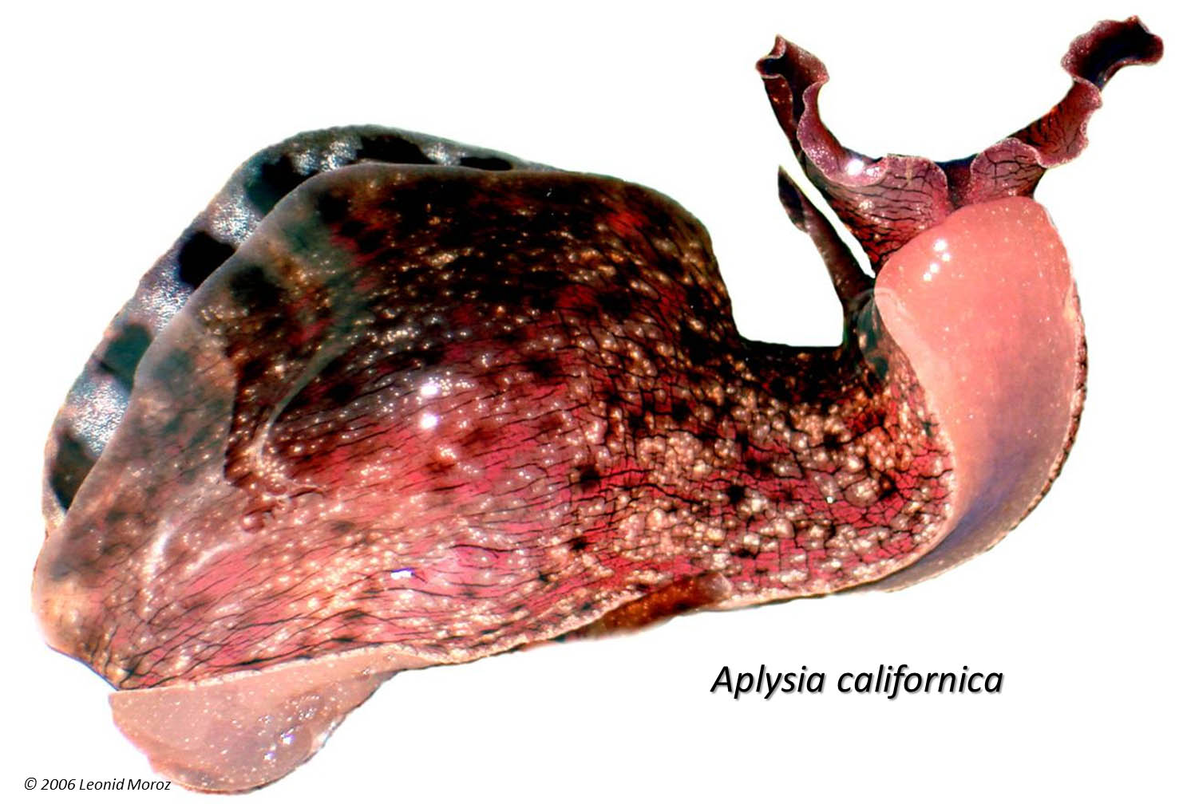
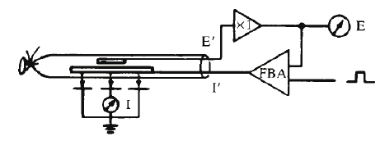
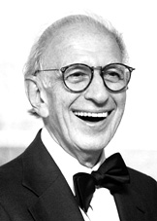


Alternative approaches to understanding the brain
Excitability
Memory
Hodgkin & Huxley
Eric Kandel
Notes:
It is sometimes said that the connectome may not sufficient but it is still necessary to understand the brain.
This is superficially convincing but also misleading. A lot of basic research did not rely on such brute-force strategies but rather on careful choice of experimental model systems adequate for a particular question, to understand *principles* of brain function that are not specific of particular structures.

Slide 14


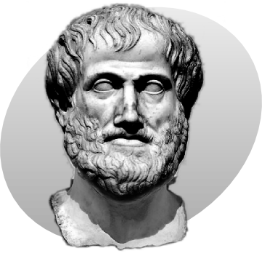
Two approaches to gravity
Aristotle: « Speed of fall is proportional to weight »
Notes:
Isn’t even dangerous to insist that theories should immediately explain the natural systems of interest in their complexity? Let’s how that works for understanding gravity.

Slide 15
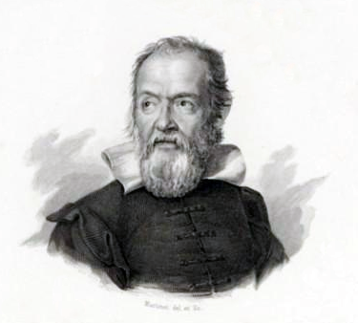
Two approaches to gravity
Galileo: « Falling bodies accelerate uniformly »
Notes:
Point: the feather

Slide 16


Slide 17
Summary
Known connectomes have been disappointing
There is much beyond the connectome; neurons are not simple stereotypical elements
Relation between connectivity and function is weak
Connectivity is not discriminant for theories
Detail can be overwhelming and confusing

